Slide 1
BATCH - 13
DESIGN AND IMPLEMENTATION IN WEB APPLICATION OF EFFECTING HEART DISEASE AND DIABETES FOR PREDICTING COVID-19
Team Members: Panithavya.M (211417104142)
Meenakshi.G (211417104145)
Sandhiya.K (211417104236)
Guide Details: Mrs. A. Kanchana M.E
Assistant Professor

Slide 2
INTRODUCTION
Heart is one of the most vital organs for the proper functioning of our body. According to a survey by WHO, 78% of the worldwide deaths occurs for heart patients due to COVID-19 and also, more deaths occur in low and middle income countries including India.
The main challenge is to accurately predict the existence of CVDs(cardiovascular disease) inside human body. The older techniques have not been very successful in efficiently predicting the heart diseases.
Many medical instruents are available in the market for predicting covid-19 for heart and diabetes patients,but there are some drawbacks in the past project which others done.We included both diabetes and heart disease evaluating in our project.
Age, Sex, Blood Pressure, Cholesterol, Blood Sugar, ECG, Maximum heart rate, Diabetes, etc. and some lifestyle factors like obesity, eating unhealthy food, less physical activity, smoking, consumption of alcohol ,etc. are some of the major risk factors that leads to heart diseases.

Slide 3
Most of the lifestyle risk factors are controllable. In the last few decades, medical science has used the technological advancements very well to improve the quality of healthcare.
There are around 463 million diabetic people around the world who can be benefited by smart healthcare technologies to improve their quality of life. Diabetes may lead to heart disease, kidney infection, blindness and nerve damages. It has been observed that severe acute respiratory syndrome corona virus 2 (SARS-CoV-2) has infected the diabetic patients largely among the others.
SARS-CoV-2 has affected mainly to old-age people and persons having underneath health conditions like mainly heart disease and diabetes disease.
These advancements in technology have paved ways for accurate diagonise and prediction of Diseases. . Machine learning could be a very good choice to achieve high accuracy for predicting covid -19 for heart diseases and diabetes patients. Our website is helpful to analyse large amounts of data and Predict Heart Diseases and Diabetes , according to this result we can analyse, whether the patient can affect by covid or not.

Slide 4
LITERATURE SURVEY
LITERATURE SURVEY
TITLE | AUTHOR NAME | YEAR | METHODOLOGY | MERITS | DEMERITS | REFERENCE LINK
Smart Healthcare for Diabetes during COVID-19 | Amit M. Joshi Urvashi P. Shukla / Saraju P. Mohanty | 2020 | Data mining algorithm KNN Algorithm, Namely Decision Tree, Multilayer Perception Support Vector Machine. | Make awareness of self-care device to mange the diabetes properly. | Lack of access to have cost-effective solutions for medical emergency in remote areas. | https://www.researchgate.net/publication/343855809_Smart_Healthcare_for_Diabetes_during_COVID-19
Prediction of Heart Disease Using Machine Learning Algorithms | Santhana Krishnan. J, Geetha. S /Rajesh | 2019 | KNN Algorithm, Namely Decision Tree, Multilayer Perception Support Vector Machine. | •The mortality rate can be drastically controlled if the disease is detected at the early stages and preventative measures are adopted as soon as possible | • Heart disease prediction is challenging and very important in the medical field, some error may occur in results. | https://ieeexplore.ieee.org/document/8474922
A Hybrid Machine Learning Approach for Prediction of Heart Diseases | Sanchayita Dhar, Krishna Roy, Tanuree Dey, Pritha, Datta, Ankur Biswas | 2018 | KNN Algorithm, Namely Decision Tree, Multilayer Perception Support Vector Machine. | •This method is quick and efficient detection technique providing better accuracy and precision. | • Must have a total cardiovascular checkup,it will be expensive. | https://ieeexplore.ieee.org/document/8777531
An Investigation of Heart Disease Prediction Techniques. | G. Shanmugasundaram, V. Malar Selvam, R. Saravanan, S.Balaji. | 2018 | KNN Algorithm, Namely Decision Tree, Multilayer Perception Support Vector Machine. | •Make awareness on smart healthcare technologies such as health and telemedicine. | •This work concludes with the key challenges which are not yet explored. | https://ieeexplore.ieee.org/document/8541165
"Supervised Machine Learning Algorithm for Detection of Cardiac Disorders | Sneha Borkar, M. N. Annadate. | 2018 | Support Vector Machine Algorithm | • At an initial stage the prediction of heart disease can save human lives. •The proposed system achieved the accuracy of 98.30%. | •Echocardiogram contains less information hence the diagnosis of the disease from the •Echocardiogram videos is time consuming task. It required more human efforts to make a decision.• | https://ieeexplore.ieee.org/document/8697795

Slide 5
TITLE | AUTHOR NAME | YEAR | METHODOLOGY | MERITS | DEMERITS | REFERENCE LINK
A Cloud Based Four-Tier Architecture for Early Detection of Heart Disease with Machine Learning Algorithms. | Md. Razu Ahmed, S M Hasan Mahmud, Md. Altab Hossin, Hosney Jahan, Shek Rashed Haider Noori. | 2018 | KNN Algorithm | cloud-based 4- tier architecture that can significantly improve the prediction and monitoring of patient's health information | heart disease is a prominent public chronic diseaseIn growing amount of health care systems, patients are offered expensive therapies and operation that is quiet expensive for developing countries | https://ieeexplore.ieee.org/document/8781022
A comprehensive investigation and comparison of Machine Learning Techniques in the domain of heart disease", IEEE, 2017 | Seyedamin Pouriyeh, Sara Vahid, Giovanna Sannino, Giuseppe De Pietro, Hamid Arabnia, Juan Gutierrez. | 2017 | KNN Algorithm, Namely Decision Tree, Multilayer Perception Support Vector Machine. | The results of the experiments indicate that the SVM method using the boosting technique outperforms the other aforementioned methods | • Heart disease prediction is challenging and very important in the medical field, some error may occur in results. | https://ieeexplore.ieee.org/document/8024530
Dagnosing of heart diseases using average k-nearest neighbor algorithm of data mining | C. Kalaiselvi | 2016 | KNN Algorithm | The main objective of this research work is to diagnose heart disease with reduced number of attributes that are relevant to heart diseases | The most important and prevalent diseases that commonly occur in people and causes 80% of death in country is heart disease | https://ieeexplore.ieee.org/document/7724833
Cardiovascular Disease Prediction System using Genetic Algorithm and Neural Network | Bhuvaneswari Amma N.G. | 2012 | Genetic Algorithm | The classification accuracy obtained using this approach is 94.17% | I will be more time taken to Predicting the disease | https://ieeexplore.ieee.org/abstract/document/6179185
Combination Data Mining Methods with New Medical Data to Predicting Outcome of Coronary Heart Disease | Yanwei Xing, Jie Wang, Zjijong, Yonghong Gao. | 2007 | Data mining algorithm, KNN Algorithm PageRank Algorithm, etc. | The results indicated that the SVM is the best predictor with 92.1 % accuracy on the holdout sample artificial neural networks came out to be the second with91.0% accuracy | Lack of access to have cost-effective solutions for medical emergency in remote areas. | https://ieeexplore.ieee.org/document/4420369

Slide 6
PROBLEM STATEMENT
Heart and Diabetes disease is considered as one of the main causes of death due to covid around the world. It is very difficult to be predicted by the medical practitioners as it is a complex task .
An automated system in medical diagnosis would increase medical efficiency and would also help in reducing costs. We will design a system that can efficiently discover the rules to predict heart and diabetes disease in patients based on the given parameters about their health. The goal is to find the hidden patterns by employing machine learning algorithms, which are quick and reliable enough to predict the Covid-19 by finding the presence of heart and diabetes disease in users and patients.

Slide 7
TECHNOLOGY STACK
HARDWARE REQUIREMENTS
Hard Disk : 500GB and Above
RAM : 4GB and Above
Processor : I3 and Above
SOFTWARE REQUIREMENTS
Operating System : Windows 7, 8, 10 (64 bit)
Software : Python
Tools : Anaconda (Jupiter Note Book IDE)

Slide 8
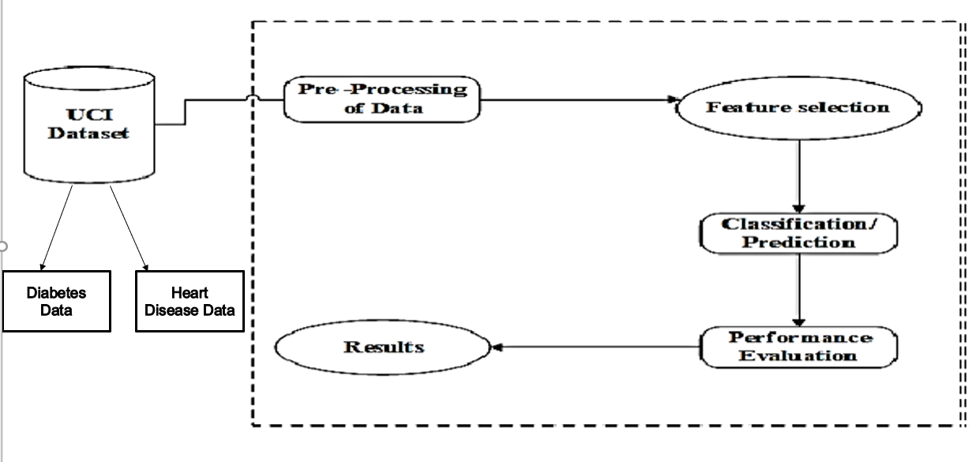
SYSTEM ARCHITECTURE

Slide 9
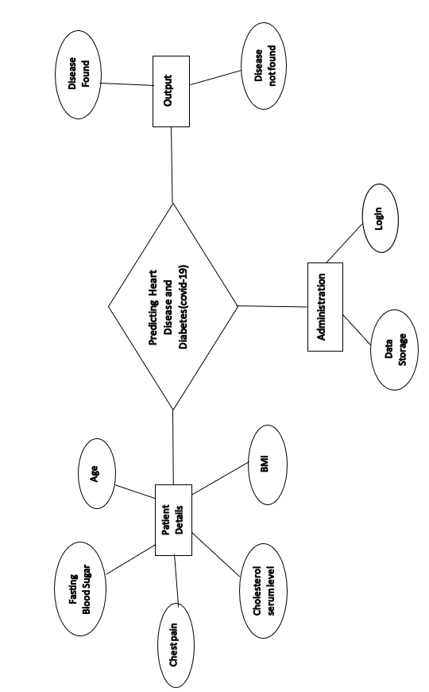
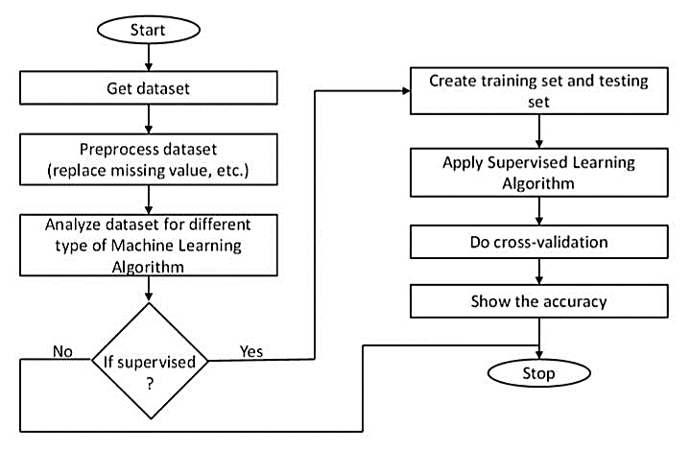
SYSTEM DESIGN ER DIAGRAM

Slide 10
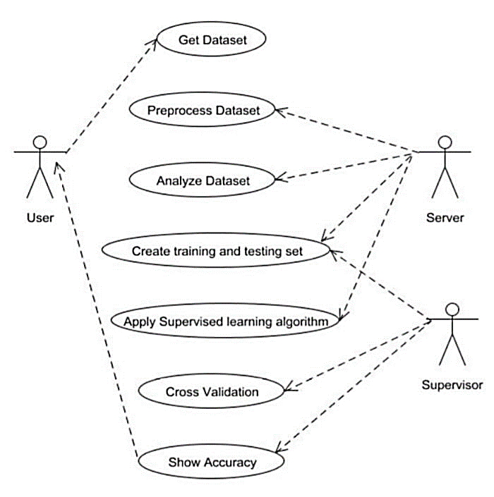
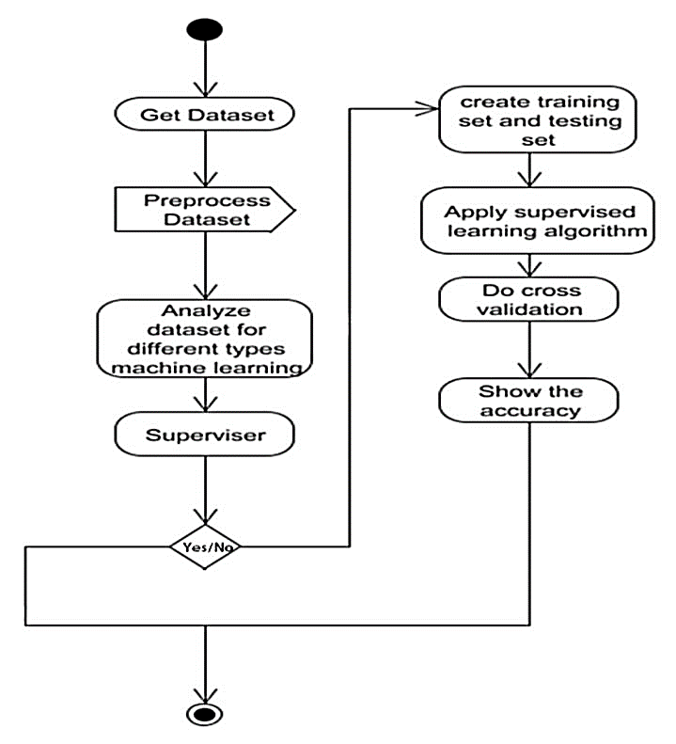
UML DIAGRAMS
Use Case Diagram
Activity Diagram

Slide 11
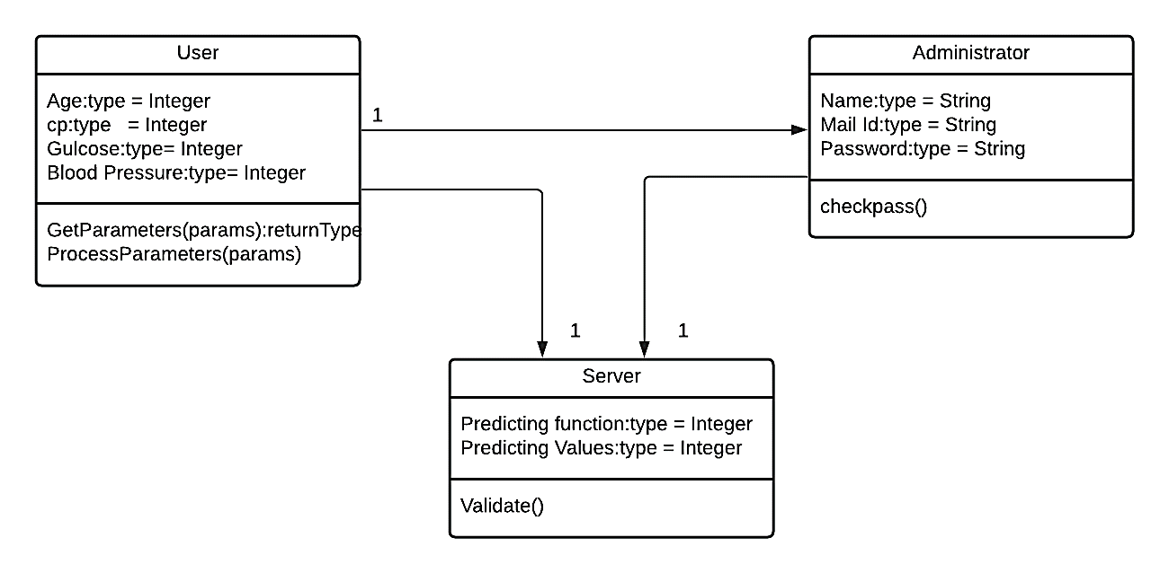
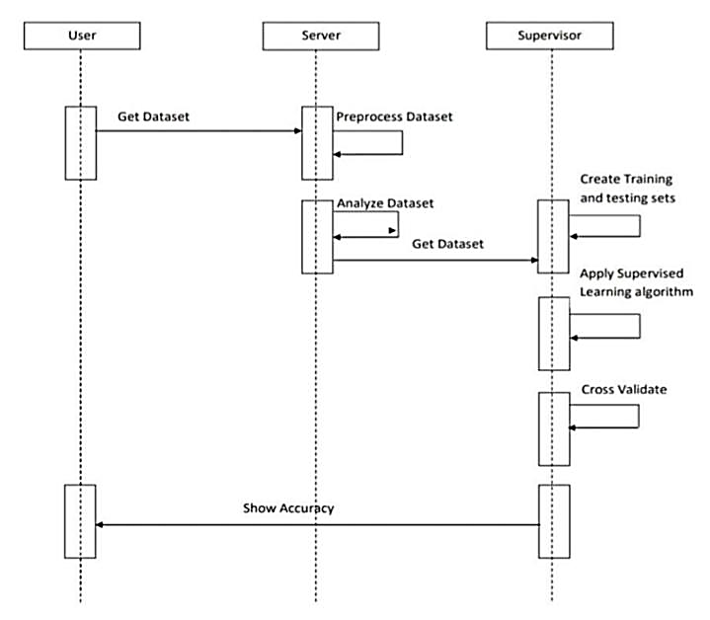
Class Diagram
Sequence Diagram

Slide 12
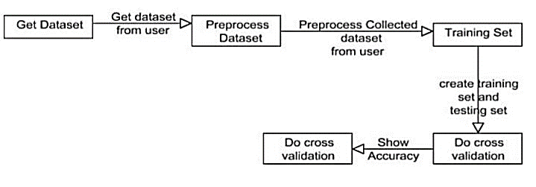
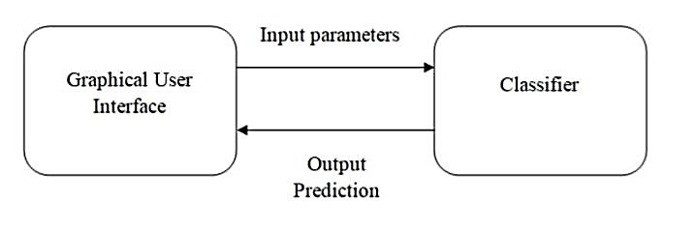
Collaboration Diagram
Interface Diagram

Slide 13
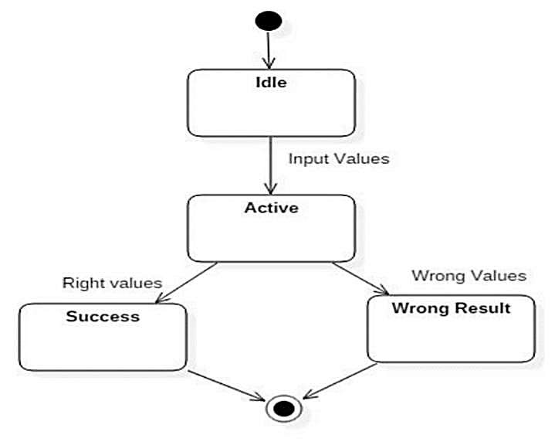
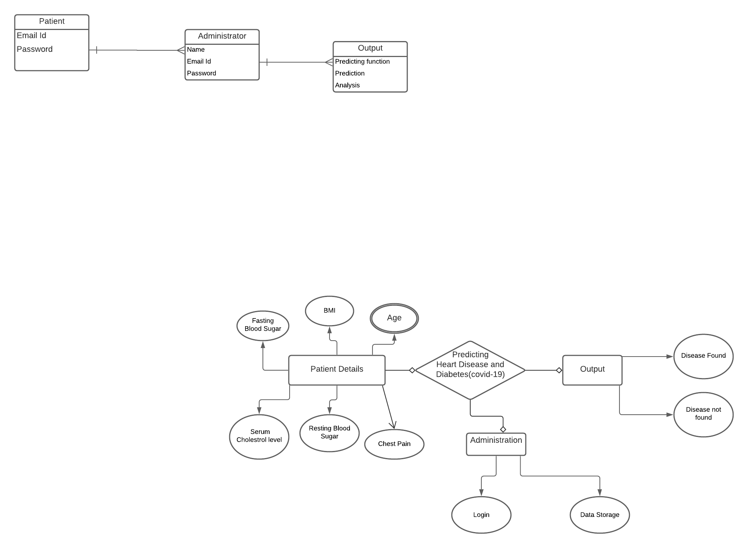
State Machine Diagram DB DESIGN

Slide 14
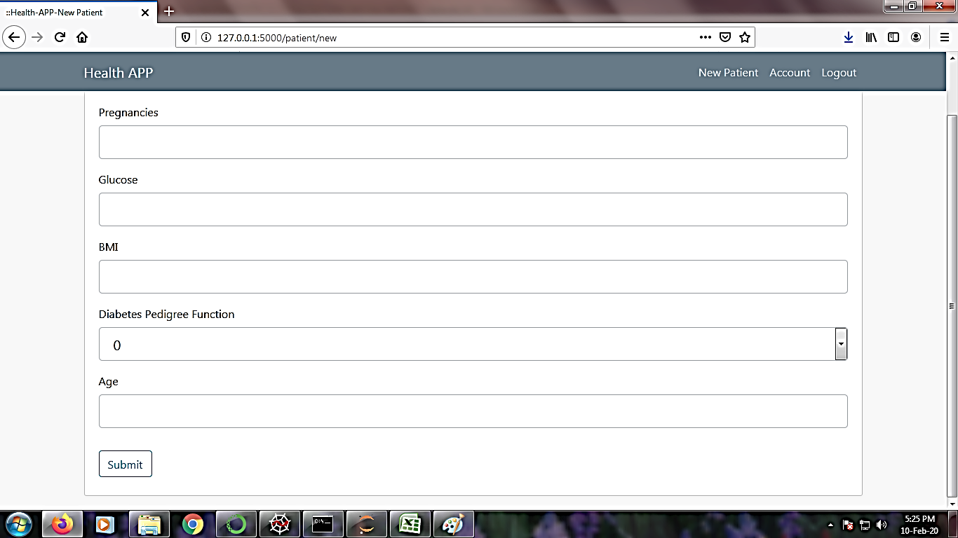
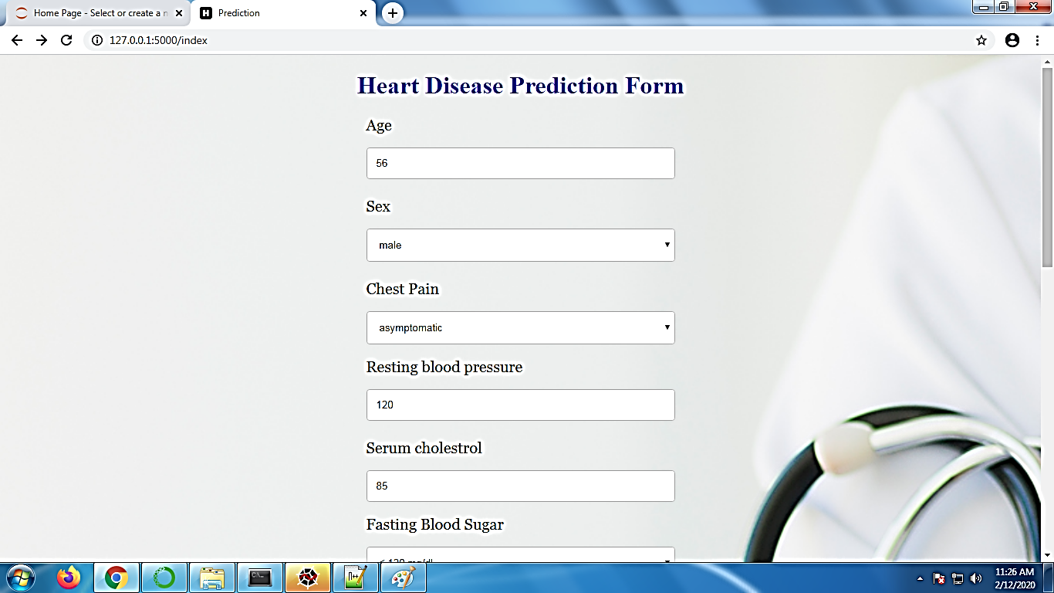
INPUT DESIGN
DIABETES FORM
HEART DISEASE FORM

Slide 15
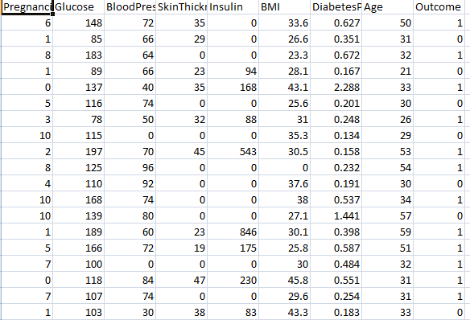
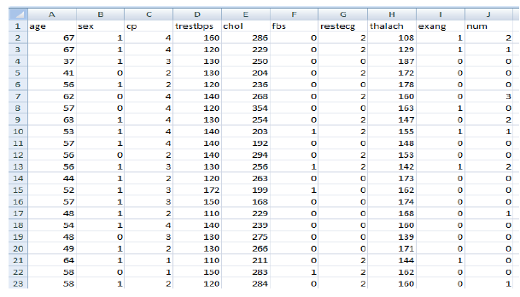
Dataset
Diabetes dataset
Heart Disease Dataset

Slide 16
MODULES DESCRIPTION
Dataset Description
Data Pre-Processing
Feature Selection
Classification Modeling
Performance Measures

Slide 17
DATASET DESCRIPTION:
The objective of the dataset is to predict whether or not a patient has diabetes and heart diseases, based on certain diagnostic measurements included in the dataset.
The datasets consists of several medical predictor variables and one target variable, Outcome. Predictor variables include the number of pregnancies the patient has had, their BMI, insulin level, age, and so on.
Pregnancies: Number of times pregnant
Glucose: Plasma glucose concentration a 2 hours in an oral glucose tolerance test
Blood Pressure: Diastolic blood pressure (mm Hg)
Skin Thickness: Triceps skin fold thickness (mm)
Insulin: 2-Hour serum insulin (mu U/ml)
BMI: Body mass index (weight in kg/(height in m)^2)
Diabetes Pedigree Function: Diabetes pedigree function
Age: Age (years)
Outcome: Class variable (0 or 1) 268 of 768 are 1, the others are 0

Slide 18
DATA PRE PROCESSING:
Diabetes disease and Heart Disease data is pre-processed after collection of various records.
The dataset contains a total of 769 patient records, where 6 records are with some missing values.
Those 6 records have been removed from the dataset and the remaining 763 patient records are used in pre-processing.

Slide 19
FEATURE SELECTION:
From among the 8 attributes of the data set, one attributes pertaining to age is used to identify the personal information of the patient.
The remaining 7 attributes are considered important as they contain vital clinical records.
Clinical records are vital to diagnosis and learning the severity of diabetes disease and heart disease.

Slide 20
CLASSIFICATION MODELING:
The clustering of datasets is done on the basis of the variables and criteria of Decision Tree (DT) features. Then, the classifiers are applied to each clustered dataset in order to estimate its performance. The best performing models are identified from the above results based on their low rate of error.
Decision Trees Classifier
Support Vector Classifier
Random Forest Classifier
K Nearest neighbors

Slide 21
PERFORMANCE MEASURES:
Several standard performance metrics such as accuracy, precision and error in classification have been considered for the computation of performance efficiency of this model.
K Nearest neighbors : 78.571
Support Vector Classifier : 73.376
Decision tree : 68.181
Random Forest : 75.974

Slide 22

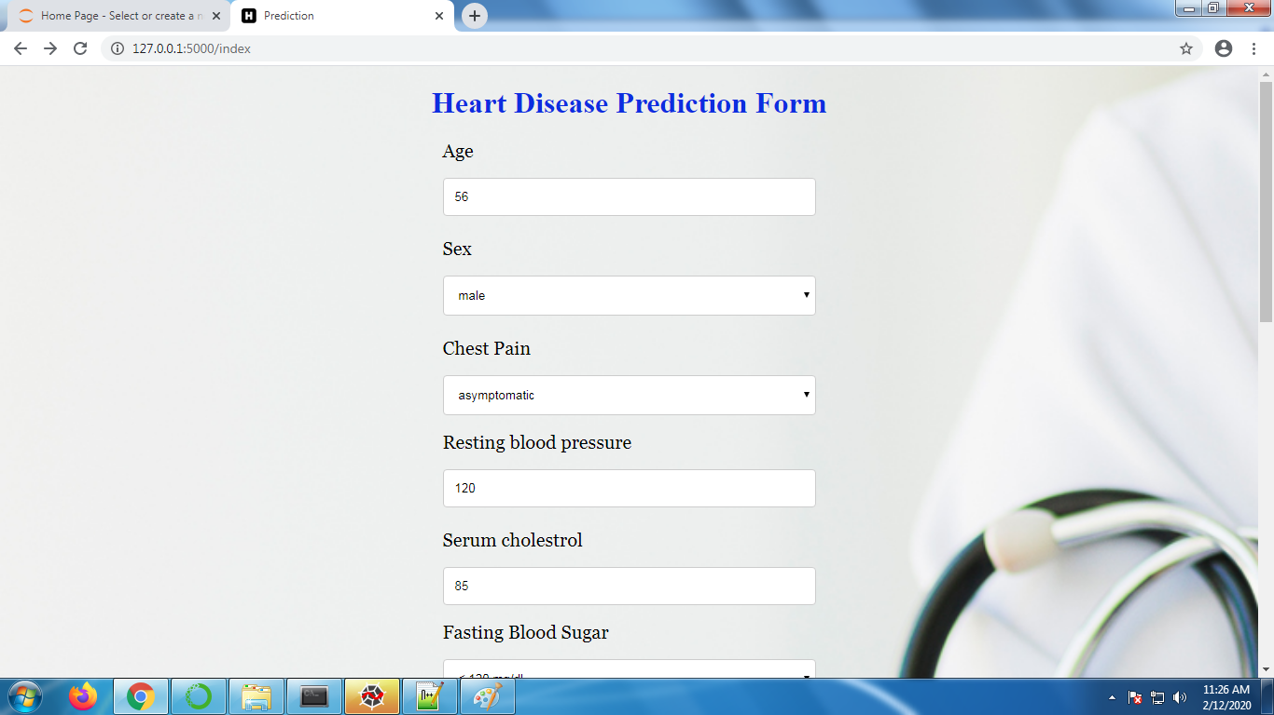
SAMPLE SCREENSHOTS
Home Screen
Input Field

Slide 23


Predicited Output (i)
Predicted Output (ii)

Slide 24
CONCLUSION
At first, the four algorithms were implemented. Datasets were trained for all the algorithms individually. After this, all of them were tested. The most efficient algorithm was to be selected based on various criteria. We found out that KNN algorithm was the most efficient out of the four algorithms . Thus, KNN algorithm was further implemented using a better user interface in form of a web application. For this HTML5, CSS, JS and Flask (Python’s micro web-framework) were used. This would help the end users get a preliminary prediction about the condition of their heart and Diabetes. Since heart and Diabetic patients are a major killer for covid-19 in India and throughout the world, application of a promising technology like machine learning to the initial prediction of Covid-19 will have a profound impact on the society.
This will tell the user if they are at a risk and if they need to visit the doctor. This will help reduce the death rate due to covid. Hence by using the above approach successful analysis of heart diseases and Diabetes of the individual was performed and the result was obtained which predicted the risk of Covid-19 based on the parameters provided by the user.

Slide 25
REFERENCES
[1] Himanshu Sharma, M A Rizvi. : “Prediction of Heart Disease using Machine Learning Algorithms: A Survey ”, International Journal on Recent and Innovation Trends in Computing and Communication, Volume: 5 Issue: 8 , 2017.
[2] Sanchayita Dhar, Krishna Roy, Tanuree Dey, Pritha, Datta, Ankur Biswas.: "A Hybrid Machine Learning Approach for Prediction of Heart Diseases", IEEE, 2018.
[3] G. Shanmugasundaram, V. Malar Selvam, R. Saravanan, S.Balaji.: "An Investigation of Heart Disease Prediction Techniques", IEEE, 2018.
[4] Md. Razu Ahmed, S M Hasan Mahmud, Md. Altab Hossin, Hosney Jahan, Shek Rashed Haider Noori.: "A Cloud Based Four-Tier Architecture for Early Detection of Heart Disease with Machine Learning Algorithms", IEEE, 2018.
[5] Seyedamin Pouriyeh, Sara Vahid, Giovanna Sannino, Giuseppe De Pietro, Hamid Arabnia, Juan Gutierrez.: "A comprehensive investigation and comparison of Machine Learning Techniques in the domain of heart disease", IEEE, 2017.

Slide 26
[6] Amit M. Joshi, Urvashi P. Shukla, Saraju P. Mohanty, “Smart Healthcare for Diabetes during COVID-19”, IEEE, 2020.
[7] Shetty, “Diabetes disease prediction using data mining”, IEEE, 2017.
[8] Zhilbert Tafa, “An intelligent system for diabetes prediction”, IEEE, 2020.
[9] M Rout, “Prediction of Diabetes Risk based on Machine Learning Techniques”, IEEE, 2020.
[10] GG Ladha, “A computation analysis to predict diabetes based on data mining”, IEEE, 2018.

Slide 27
PUBLICATION LINK:
International journal of Engineering science and computing (IJESC)
Volume 11 Issue No. 04 April 2021
https://www.ijesc.org/upload/c9720b7b6470882fc24099a69cbf1d1f.Design%20and%20Implementation%20in%20Web%20Application%20of%20Effecting%20Heart%20Disease%20and%20Diabetes%20for%20Predicting%20Covid-19-converted.pdf

Slide 28
THANK YOU

